Slide 1
Introduction to Software Design
BHAVANA
DAY 43
03/06/2024
Notes:
Notes for title slide

Slide 2
Outline
The software challenge and the software life cycle
Activities of each phase of the software life cycle
Using top-down design and object-oriented design
Managing complexity:
Data abstraction
Procedural abstraction
Information hiding
Class diagrams document interactions between classes

Slide 3
Outline (2)
Abstract data types:
Role in modeling
Implementing them with classes and interfaces
Use cases: tool to document interaction with a user
Software design process example:
Design and implementation of an array-based telephone directory
Sequence diagrams: tool for documenting the interaction between multiple classes used in a program

Slide 4
The Software Challenge
Software is ...
Used for a long time
Updated and maintained
By people who did not write it
Initial specification may be incomplete
Specification clarified through extensive interaction between user(s) and system analyst(s)
Requirements specification needed at the beginning of any software project
Designers and users should both approve it!

Slide 5
Things Change!
Users’ needs and expectations change
Use reveals limitations and flaws
Desire for increased convenience, functionality
Desire for increased performance
Environment changes
Hardware, OS, software packages (“software rot”)
Need to interact with clients, parent org., etc.
Law and regulations change
Ways of doing business
Style, “cool” factor

Slide 6
The Software Life Cycle
Software goes through stages as it moves from initial concept to finished product
The sequence of stages is called a life cycle
Must design and document software:
In an organized way for:
Understanding and ...
Maintenance (change) after the initial release
The maintainer is not necessarily the author!
... and even authors forget
... and no one can keep all details in mind at once

Slide 7
Software Life Cycle Models: The Waterfall Model
Simplest way to organizing activities in stages
Activities are:
Performed in sequence
Result of one flows (falls) into the next
The Waterfall Model is simple ... but unworkable
Fundamental flaw: Assumption that each stage can and must be completed before the next one occurs
Example: User may need to see finished product to express true requirements!

Slide 8
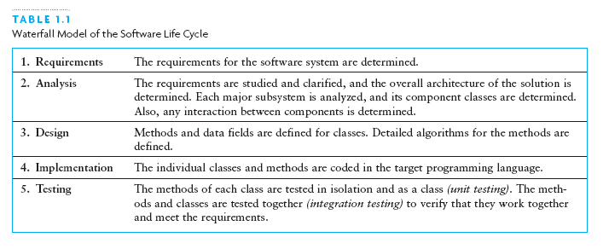
Waterfall Model

Slide 9
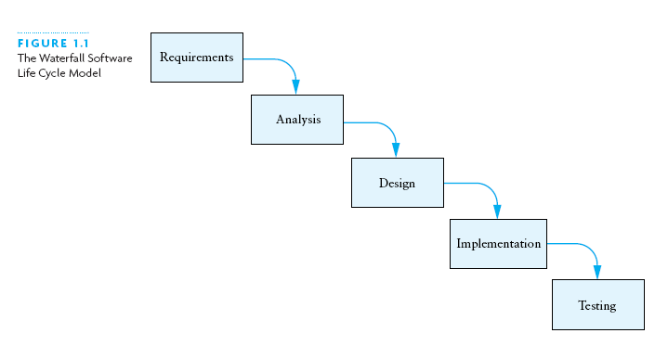
Waterfall Model (2)

Slide 10
Other Software Life Cycle Models
Common theme among models: stages or cycles
Unified Model:
Cycles are called phases and iterations
Activities are called workflows
The four phases of the Unified Model:
Inception
Elaboration
Construction
Transition

Slide 11
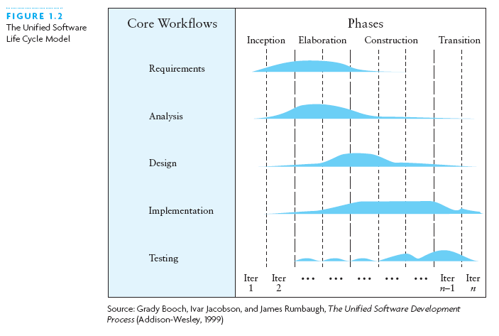
Other Software Life Cycle Models (2)

Slide 12
Software Life Cycle Activities
Activities essential for successful development:
Requirements specification
Architectural, component, & detailed designs
Implementation
Unit, integration, and acceptance testing
Installation and maintenance

Slide 13
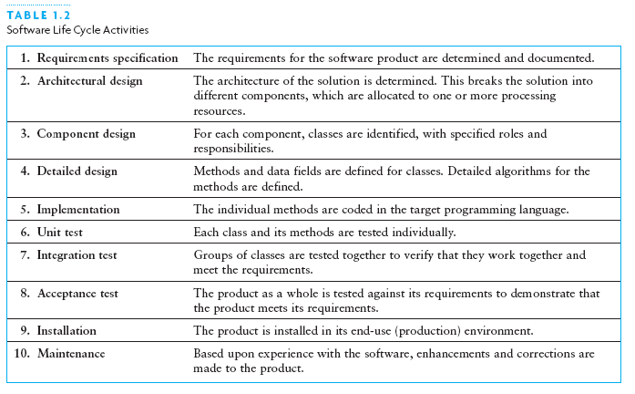
Software Life Cycle Activities Defined

Slide 14
Software Life Cycle Activities (more)
Requirements Specification
System analyst works with users to clarify the detailed system requirements
Questions include format of input data, desired form of any output screens, and data validation
Analysis
Make sure you completely understand the problem before starting the design or program a solution
Evaluate different approaches to the design

Slide 15
Software Life Cycle Activities (continued)
Design
Top-down: break system into smaller subsystems
Object-oriented: identify objects and their interactions
UML diagrams: tool to show interactions between:
Classes (inside the system)
Classes and external entities

Slide 16
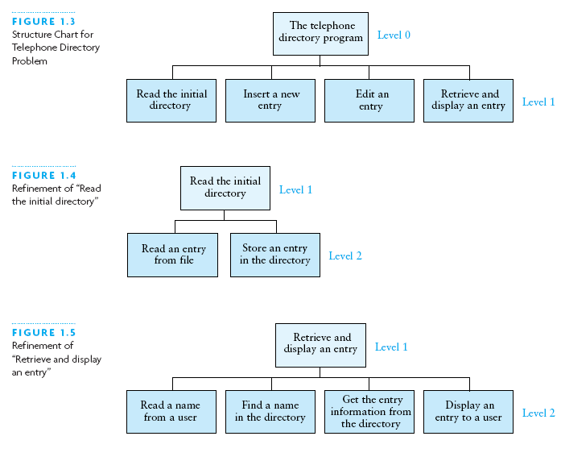
Example of Top-Down: Stepwise Refinement

Slide 17
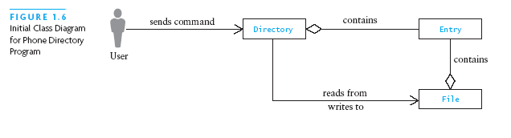
Example of Object-Oriented: Class Diagram

Slide 18
Using Abstraction to Manage Complexity
An abstraction is a model of a physical entity or activity
Models include relevant facts and details
Models exclude matters irrelevant to system/task
Abstraction helps programmers:
Complex issues handled in manageable pieces
Procedural abstraction: distinguishes ...
What to achieve (by a procedure) ...
From how to achieve it (implementation)
Data abstraction: distinguishes ...
Data objects for a problem and their operations ...
From their representation in memory

Slide 19
Using Abstraction to Manage Complexity (2)
If another class uses an object only through its methods, the other class will not be affected if the data representation changes
Information hiding: Concealing the details of a class implementation from users of the class
Enforces the discipline of data abstraction

Slide 20
Abstract Data Types, Interfaces, and Pre- and Post-conditions
A major goal of software engineering: write reusable code
Abstract data type (ADT): data + methods
A Java interface is a way to specify an ADT
Names, parameters, return types of methods
No indication of how achieved (procedural abstraction)
No representation (data abstraction)
A class may implement an interface
Must provide bodies for all methods of the interface

Slide 21
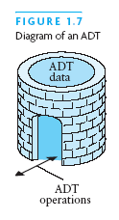
Abstract Data Types, Interfaces, and Pre- and Postconditions (2)

Slide 22
Abstract Data Types, Interfaces, and Pre- and Postconditions (continued)
You cannot instantiate (new) an interface
But you can:
Declare a variable that has an interface type
Use it to reference an actual object, whose class implements the interface
A Java interface is a contract between
The interface designer and ...
The coder of a class that implements the interface
Precondition: any assumption/constraint on the method data before the method begins execution
Postcondition: describes result of executing the method

Slide 23
Requirements Analysis: Use Cases, and Sequence Diagrams
Analysis first step: study input and output requirements:
Make sure they are understood and make sense
Use case:
User actions and system responses for a sub-problem
In the order that they are likely to occur
Sequence diagram:
Shows objects involved across the horizontal axis
Shows time along the vertical axis
See page 26 for an example; shows:
User, PDApplication, PhoneDirectory, BufferedReader, PDUserInterface object + a number of method calls

Slide 24
Design of an Array-Based Phone Directory
Case study shows:
Design
Implementation
Testing of a software-based phone directory
In UML class diagrams:
+ sign next to a method/attribute means it is public
- sign next to a method/attribute means it is private

Slide 25
Design of Array-Based Phone Directory
Classes/interfaces to design include:
PDUserInterface: interface; later we consider:
Console (command line) UI class
Graphical (JOptionPane) UI class
PDApplication: main / driving class
PhoneDirectory: interface
ArrayBasedPD: class implementing PhoneDirectory
DirectoryEntry: class, for one item in the directory

Slide 26
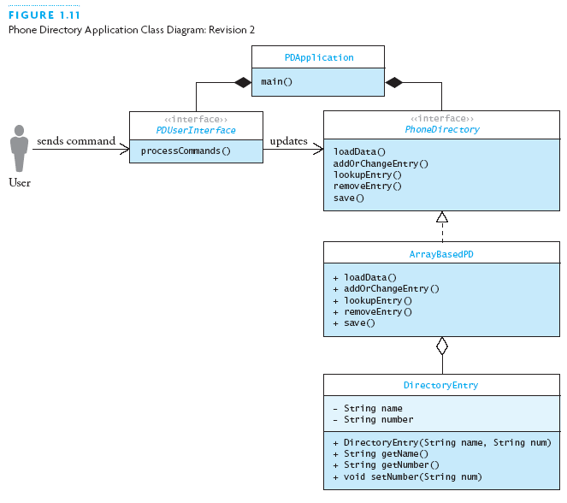
Design of Array-Based Phone Directory (2)

Slide 27
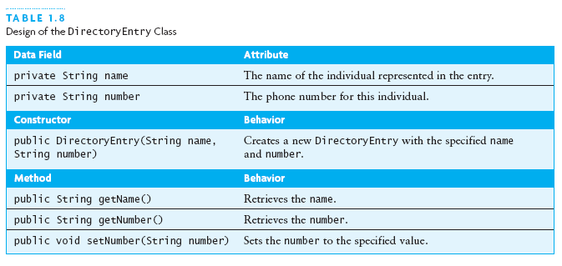
Design of Array-Based Phone Directory (3)

Slide 28
Design of DirectoryEntry
Simple class, similar to Person in Java review:
Two private fields, for name and number
Two-argument constructor
Get methods for both fields
Set method for number (only)

Slide 29
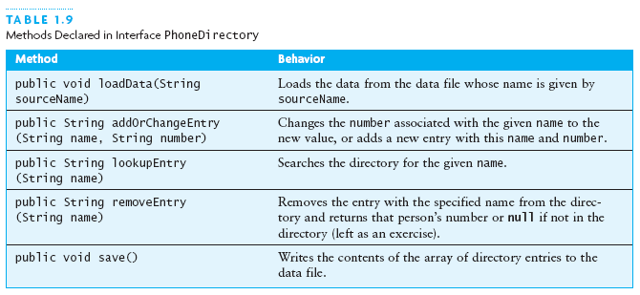
Design of Array-Based Phone Directory (4)

Slide 30
The PhoneDirectory Interface
/**
* The interface for the telephone directory.
* @author Koffman & Wolfgang
*/
public interface PhoneDirectory {
...
}
Shows syntax of an interface
Shows a javadoc comment and the @author tag

Slide 31
PhoneDirectory.loadData
/** Load the data file containing the
* directory, or establish a connection with
* the data source.
* @param sourceName The name of the file
* (data source) with the phone directory
* entries
*/
void loadData (String sourceName);
Shows syntax of method in an interface (note ;)
Shows a javadoc comment with the @param tag
Since returns void, no @return tag

Slide 32
PhoneDirectory.lookupEntry
/** Look up an entry.
* @param name The name of the person
* to look up
* @return The number, or null if name
* is not in the directory
*/
String lookupEntry (String name);
Shows a javadoc comment with the @return tag
I prefer a space before the ( in a declaration (not a call)

Slide 33
PhoneDirectory.addOrChangeEntry
/** Add an entry or change an existing entry.
* @param name The name of the person being
* added or changed
* @param number The new number to be assigned
* @return The old number or, if a new entry,
* null
*/
String addOrChangeEntry (String name,
String number);
Shows a javadoc comment with two @param tags

Slide 34
PhoneDirectory.removeEntry
/** Remove an entry from the directory.
* @param name The name of the person to be
* removed
* @return The current number. If not in
* directory, return null
*/
String removeEntry (String name);

Slide 35
PhoneDirectory.save
/** Method to save the directory.
* pre: The directory is loaded with data.
* post: Contents of directory written back to
* the file in the form of name-number pairs
* on adjacent lines;
* modified is reset to false.
*/
void save ();
Illustrates pre/post conditions

Slide 36
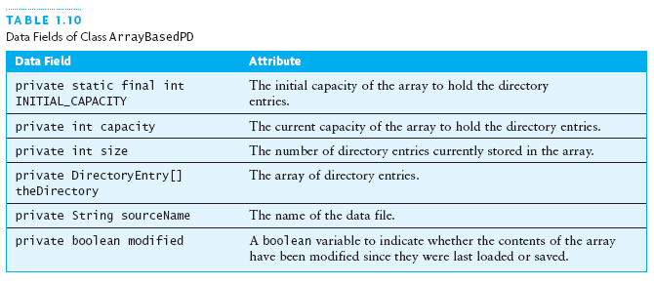
Design of Array-Based Phone Directory (5)

Slide 37
Design of ArrayBasedPD.loadData
Input: a file name; Effect: read initial directory from the file
Create a BufferedReader for the input
Read the first name
while the name is not null
Read the number
Add a new entry using method add
Read the next name

Slide 38
Design of ArrayBasedPD.addOrChangeEntry
Input: name and number; Effect: change number of existing entry, or make new entry if there was none
Call method find to see if the name is in the directory
if the name is in the directory
change number with DirectoryEntry.setNumber
Return the previous value of the number
else
Add a new entry using method add
Return null

Slide 39
Design of Array-Based Phone Directory (6)
Remaining method designs proceed along the same lines
The class diagram changes, showing private fields and methods added ....

Slide 40
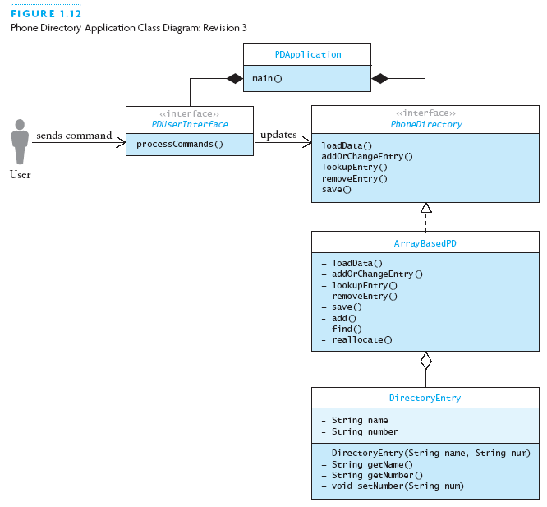
Design of Array-Based Phone Directory (7)

Slide 41
Implementing and Testing the Array-Based Phone Directory: ArrayBasedPD.java
import java.io.*;
/** This is an implementation of the
* PhoneDirectory interface that uses an
* array to store the data.
* @author Koffman & Wolfgang
*/
public class ArrayBasedPD
implements PhoneDirectory {
...
} // note: import, javadoc, implements

Slide 42
ArrayBasedPD Data Fields (1)
// Data Fields (with javadoc comments)
/** The initial capacity of the array */
private static final int INITIAL_CAPACITY = 100;
/** The current capacity of the array */
private int capacity = INITIAL_CAPACITY;
/** The current size of the array (number of
directory entries) */
private int size = 0;

Slide 43
ArrayBasedPD Data Fields (2)
/** The array to contain the directory data */
private DirectoryEntry[] theDirectory =
new DirectoryEntry[capacity];
/** The name of the data file that contains the
directory data */
private String sourceName = null;
/** Boolean flag indicates if the directory was
modified since it was loaded or saved. */
private boolean modified = false;

Slide 44
ArrayBasedPD.loadData
public void loadData (String sourceName) {
// Remember the source name.
this.sourceName = sourceName;
try { ...
} catch (FileNotFoundException ex) {
// Do nothing — no data to load.
return;
} catch (IOException ex) {
System.err.println(“Directory load failed.");
ex.printStackTrace();
System.exit(1);
}
}

Slide 45
ArrayBasedPD.loadData (2): Inside try
BufferedReader in = new BufferedReader(
new FileReader(sourceName));
while (true) {
String name, number;
// read name and number from succeeding lines
if ((name = in.readLine()) == null) break;
if ((number = in.readLine()) == null) break;
// insert entry (if got both name and number)
add(name, number);
}
in.close(); // should always close input
Slightly different loop approach from the text
Same assign-in-if-condition “hack”

Slide 46
ArrayBasedPD.loadData (3): alternate
boolean more = true;
while (more) {
more = false;
String name = in.readLine();
if (name != null) {
String number = in.readLine();
if (number != null) {
add(name, number);
more = true;
}
}
}
Nested if statements not as pleasant (what if 7 inputs?)
Control variables tend to be harder to understand/get right

Slide 47
ArrayBasedPD.addOrChangeEntry
public String addOrChangeEntry (String name,
String number) {
String oldNumber = null;
int index = find(name);
if (index > -1) {
oldNumber = theDirectory[index].getNumber();
theDirectory[index].setNumber(number);
}
else {
add(name, number);
}
modified = true;
return oldNumber;
}

Slide 48
ArrayBasedPD.save
public void save() {
if (!modified) return; // save not needed
try {
// Create PrintWriter for the file.
PrintWriter out = new PrintWriter(
new FileWriter(sourceName));
...
} catch (Exception ex) {
System.err.println(“Directory save failed");
ex.printStackTrace();
System.exit(1);
}
}

Slide 49
ArrayBasedPD.save (2)
// Write each directory entry to the file.
for (int i = 0; i < size; i++) {
// Write the name.
out.println(theDirectory[i].getName());
// Write the number.
out.println(theDirectory[i].getNumber());
}
// Close the file.
out.close();
modified = false;

Slide 50
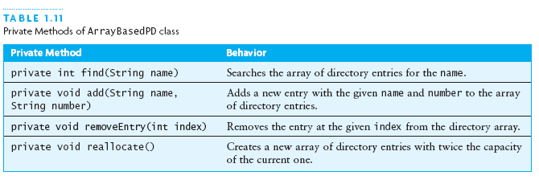
Implementing and Testing the Array-Based Phone Directory

Slide 51
ArrayBasedPD.find
private int find (String name) {
for (int i = 0; i < size; i++) {
if (theDirectory[i].getName().equals(name)) {
return i;
}
}
return -1; // Name not found.
}

Slide 52
ArrayBasedPD.add
private void add (String name, String number) {
if (size >= capacity) {
reallocate();
}
theDirectory[size++] =
new DirectoryEntry(name, number);
}
Differs from text in use of ++
Note that size means number of names stored,
while capacity means the number the array can hold

Slide 53
ArrayBasedPD.realloc
private void reallocate () {
capacity *= 2;
DirectoryEntry[] newDirectory =
new DirectoryEntry[capacity];
System.arraycopy(theDirectory, 0,
newDirectory, 0,
theDirectory.length);
theDirectory = newDirectory;
}
Arguments to arraycopy are:
fromDir, fromIndex
toDir, toIndex
number of elements to copy

Slide 54
Testing ArrayBasedPD
Empty data file
Data file with only one name-number pair
Data file with odd number of lines
Data file with more pairs than initial array size
Retrieve names not in directory as well as ones that are
After a change, verify the new information
Check that after changes, the changes, plus all new information, are in the newly written file
Note: This code does not check for empty strings!

Slide 55
Implementing PDUserInterface
Text offers two classes that implement the UI interface:
PDGUI: Uses JOptionPane for graphical UI
PDConsoleUI: Uses console stream I/O (System.in and System.out)
Text gives good recipes here that you can use as models
We will not cover them in detail here

Slide 56
Oracle Application Development Framework
Notes:
Schedule: Topic Timing
Lecture 60 minutes
Practice 0 minutes
Total 60 minutes

Slide 57
Objectives
After completing this lesson, you should be able to do the following:
Describe the Java 2, Enterprise Edition (J2EE) platform
Describe the benefits of framework-based application development
Describe the purpose and benefits of Oracle ADF
Describe the Model-View-Controller (MVC) architecture
Describe the technologies used in each of the MVC layers
Notes:
Objectives
This lesson discusses each of the components of the J2EE architecture and examines their purpose in a J2EE application. J2EE applications are deployed to a J2EE server, such as OracleAS. This lesson also describes the configuration and structure of OracleAS Containers for J2EE.

Slide 58




J2EE Platform
Is a multitiered, distributed application model
Supports component-based J2EE applications
Client Machine
J2EE Server
Database Server
Client tier
Web tier
Business tier
EIS tier
Browser/ Application
JSP/
Servlet
Business Services
Database
Notes:
J2EE Platform
J2EE defines a platform for developing, deploying, and executing applications in a multitiered, distributed application model. That is, the application logic of a J2EE application can be divided into components based on their functions and distributed to the appropriate tier on the multitiered architecture.
The slide shows a standard multitiered J2EE application model where the application logic is distributed into the following tiers:
Client-tier components, such as a Web browser or thick-client Java applications, run on the client machine.
Presentation logic is built with Web-tier components such as JavaServer Pages (JSPs) and Java servlets that run on the J2EE server.
Server-side business logic is distributed as business-tier components that run on the J2EE server.
Data is stored in the enterprise information system (EIS) tier that runs on the database server, such as Oracle Database10g.
The J2EE application components are developed in the Java programming language. When the J2EE platform is used, the J2EE components are assembled into a J2EE application, it is verified that they are in compliance with the J2EE specification, and the components are deployed to the J2EE server. The deployed applications are run and managed by the J2EE server.

Slide 59
Benefits of the J2EE Platform
“Write once, run anywhere” provides simplified component development.
J2EE separates client requirements from business logic.
J2EE provides multiple development and design scenarios:
Multitier
Web
Stand-alone client
J2EE separates development tasks into specific skill areas.
Notes:
Benefits of the J2EE Platform
J2EE takes advantage of many features of Java 2, Standard Edition (J2SE), such as the “write once, run anywhere” portability. This portability is ensured because there are multiple vendors who support the J2EE specification, making it easy to integrate distributed applications. J2EE separates business and presentation logic, making the applications easier to maintain. There are several design choices for J2EE development, including varied client access. This is discussed later in the course.
The vendors who provide the J2EE platform (Database, Application Server) are called “J2EE Product Providers.” A vendor or person who creates Web components, enterprise beans, or application clients for use in J2EE applications is called an “Application Component Provider.” A “Tool Provider” is a vendor who creates development, assembly, and packaging tools that are used by Component Providers.
The J2EE platform allows for developer specialization by component type and functionality. For example, an Enterprise JavaBeans (EJB) developer can create business logic, focusing on the business rules of the enterprise. These EJBs are used by Web component developers, who focus on the presentation of data and the user interface. These components are assembled by an “Application Assembler,” who is responsible for the deployment and administration of the application.

Slide 60
J2EE Platform: Architecture Details
Client Machine
J2EE Server
EIS tier
Browser
Web container
Business container
Client container
JSP/
Servlet
Business Services
Database
Application
Client
JNDI
RMI
JTA
JDBC
JMS
JavaMail
JAF
APIs
Notes:
J2EE Platform: Architecture Details
The J2EE architecture provides a component-based and platform-independent environment, in which each component is assembled and deployed into its corresponding container. The J2EE server provides services to handle transaction and state management, multithreading, resource pooling, and other complex low-level details, in the form of these containers. Because these underlying services are provided by the J2EE server, the developer can concentrate on solving business-related problems.
J2EE components communicate with each other by using several APIs. They access services and methods by using a remote procedure call (RPC). An RPC is a protocol used by a component to request a method located on another server or machine. The J2EE architecture provides the following APIs to support an RPC:
Java Naming and Directory Interface (JNDI): Provides naming and directory functionality to applications written in Java
Remote Method Invocation (RMI): Enables you to create distributed Java technology–based applications, in which the methods of remote Java objects can be invoked from other Java virtual machines, possibly on different hosts
Java Database Connectivity (JDBC): Enables you to access any tabular data source such as database, spreadsheets, or flat files from the Java programming language

Slide 61
Building J2EE Applications
Building J2EE applications can be complex.
Development time can be extensive.
Choosing and implementing appropriate design patterns can be overwhelming.
“Do it yourself” applications often repeat existing application code.
A large portion of “Do it yourself” code is dedicated to common tasks.
The more code you write, the greater is the chance of errors.
Using an existing application framework enables you to concentrate on your business needs.
Notes:
Building J2EE Applications
Although J2EE solves a number of problems associated with application development, it presents some obstacles of its own. Building J2EE applications can be a complex task. There is a learning curve, and development takes time. There are a number of design patterns, each of which has its own merits; however, choosing a pattern can be difficult.
Building your own application code is often a repeat of existing application code. A major part of building an application is handling common tasks (data access, security, and so on). And most importantly, the more code you write, the greater is the chance of introducing errors into the application.
Using an existing application framework solves most of these problems and enables you to focus on your business needs.

Slide 62
What Is Framework-Based Application Development?
A framework:
Is a productivity layer for building applications
Is a set of intelligent cooperating software components
Is designed to be specialized for your business
Handles the majority of common tasks with sensible behavior
Enables easy customization of default behaviors
Uses standard, proven techniques and design patterns
Notes:
What Is Framework-Based Application Development?
Framework-based development provides software components that are designed to help make modularizing and factoring easy or even automatic. A framework provides defined components that fill specific niches in the process of developing software solutions, such as queries, business logic and validation, and persistence management.
The software components should be intelligent and integrate with all other components in the framework. The components must support easy customization to meet your specific business needs. The framework should also handle the majority of common tasks with sensible and expected standard behavior. There should be a minimum of customization required for default behaviors for most applications. However, if the default behaviors do not meet specific application requirements, they should be easy to customize.
Information for Oracle Forms Developers
Forms developers are familiar with working within the framework provided by the Forms product that supplies database connectivity, transaction management, and a declarative development environment that you can customize with code. Unlike Oracle Forms, the framework is optional in JDeveloper applications, but it must support technology choices and, at the same time, provide a structure for organized productivity.

Slide 63


Understanding Framework-Based Application Development
Provides “hook points” to standard functions
You can augment
or circumvent base functionality.
Framework
Your objects have only your code.
A framework provides base functionality:
Standard behaviors
Data access methods
Transaction management
No messy code
generation
Notes:
Understanding Framework-Based Application Development
A framework provides behind-the-scenes code to manage base functionality. These functions include standard behaviors such as data validation and business logic checks. They also include data access methods and transaction management. With these built-in functions and methods, software developers can concentrate on building software specific to their businesses instead of writing low-level programs to manage the software environment.
A framework not only provides for this base functionality but it is also easily customizable. You can augment or even circumvent base functionality as your business rules dictate. A framework also provides “hook points” to standard functions. These “hooks” enable you to add behaviors to existing standard functions. For example, you should be able to easily add an audit trail procedure to the existing standard commit function.
Another important aspect of a framework is that objects that you create must contain your code only. This isolates your code and keeps it from becoming confused with the framework code. Nothing that you do in your code will break the framework. There is no code generation that you have to wrap around your custom code.

Slide 64

Oracle Application Development Framework
Reduces the complexity of J2EE development by providing visual and declarative development
Increases development productivity
Less coding, more reuse
Focus on the application, not the “plumbing”
Encourages J2EE best practices by implementing standard J2EE design patterns (MVC)
Provides a flexible and extensible environment by allowing multiple technology choices and development styles
Notes:
Oracle JDeveloper 10g: Application Development Framework (ADF)
The Oracle ADF architecture follows the MVC design pattern, enabling developers to cleanly separate:
Business logic and data access
User interface
Application flow

Slide 65
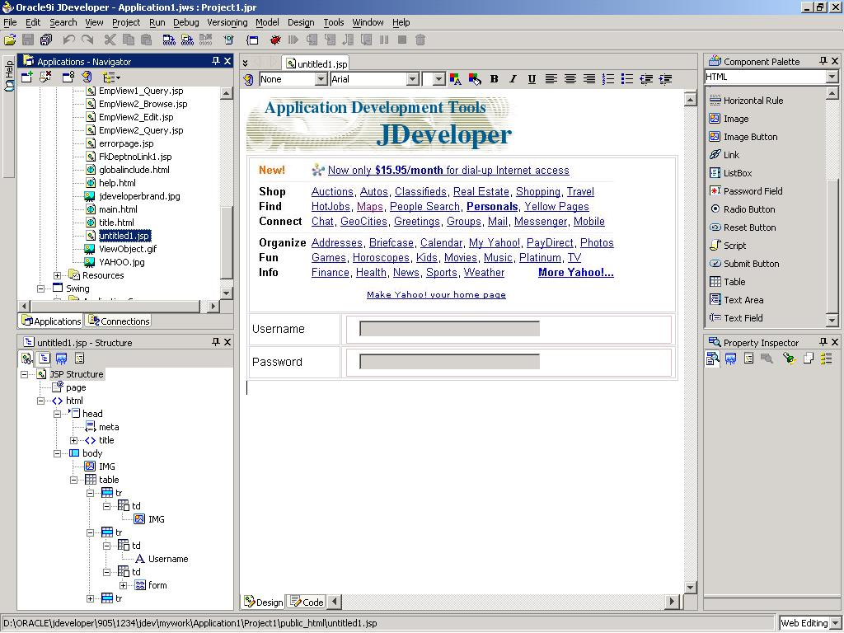
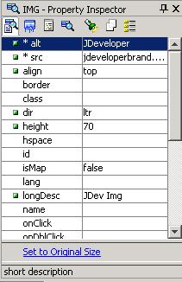
Visual and Declarative Development
Visual
WYSIWYG editors
UML modelers
Structure pane
Declarative
Structure pane
Property Inspector
Code view/design view synchronization
No separate generation step—always synchronized
Underlying code always accessible
Notes:
Visual and Declarative Development
To enable visual and declarative development, JDeveloper 10g offers a WYSIWYG editor for user interface technologies such as HTML, JavaServer Pages (JSP), ADF UIX, and Swing (ADF JClient). The code and design views are always synchronized so that there is never a generation step. For example, when you add an object in the design view, the appropriate code is added. Additionally, if you add code, the visual representation is added automatically.
Information for Oracle Forms Developers
The Property Inspector in JDeveloper is similar to the Forms Property Palette that enables you to declaratively alter the appearance and behavior of objects. In Forms, however, the coding generated by declarative development is internal to the product and it cannot be seen or modified manually. JDeveloper enables you to see the code that is generated to define objects, and if you modify the code manually, the changes are immediately synchronized with the Property Inspector.

Slide 66
Design Patterns
Design patterns:
Are proven solutions to specific problems
Are a means to an end, not the end itself
Address programming tasks, not business problems
Are reusable
Provide a framework for re-creatable results
The MVC architecture is an example of a design pattern.
Notes:
Design Patterns
Design patterns for software development are techniques of building software that helps create applications to solve business needs in a way that is consistent and re-creatable. Patterns are proven solutions to specific design and application problems. It is important to note that design patterns are not the goal but a means to achieve the application goal.
Patterns also address software design and programming needs, but not business problems. Most importantly, design patterns are reusable.
The MVC architecture is an example of a well-known and much used design pattern.

Slide 67



Model-View-Controller Architecture
MVC provides logical separation of an application.
Client
tier
Web
tier
Business tier
EIS
tier
Model
Controller
Business Services
Browser/ Application
Database
View
Notes:
Model-View-Controller (MVC) Architecture
The MVC architecture (design pattern) is a popular design pattern for Web-based applications. MVC separates an application into logical groupings of actions or activities. The following separation of activities makes MVC well suited for Web-based applications:
Model: The Model handles all data persistence and business logic. This ensures that if the persistence layer or the business logic changes, the other parts of the application can stay the same.
View: The View handles all the presentation of data from the Model. Because the View interfaces with the Model in a common way, the View can be any J2EE view (Web-based JSP, mobile device, and so on).
Controller: The Controller handles the flow of an application. It is independent of the View, so if the application flow needs to change, the Views can stay the same. The Controller also interprets application events and can send a user to a specific View based on an event.

Slide 68

MVC Structure
Controller
Handles routing to the correct page
Maps UI data changes to the Model
Display
Submit page
Data and transactions
View
Model
Renders the UI
Requests data from the Model
Sends “Events” to the Model
Allows the Controller to select the next View
Stores the application state
Responds to data requests
Encapsulates business logic
Request data
Notes:
MVC Structure
As we have seen, MVC is made up of three parts that work together, and each of the parts handles distinct actions within the application.
Controller:
Handles routing to the correct page
Maps the user interface (UI) data changes to the Model
Passes data to and from the Model
View:
Renders the UI
Requests data from the Model
Sends events to the Model
Allows the Controller to select the next View
Model:
Stores the application state
Responds to requests for data
Encapsulates business logic

Slide 69
What Is the Model?
It is a wrapper and abstraction for business services:
Handles data events from the Controller
Feeds data to the View
It manages and presents data from different Business Service types in a common way.
View
Controller
Model
Notes:
What Is the Model?
The Model in MVC provides a single point of contact for all data management. This means that the Model provides data persistence as well as it marshals data to requestors. The Model is an abstraction layer above the actual data-handling services. This abstraction provides a single and consistent interface to the data-handling services. Because of this consistent interface, business services and the data provider can change without affecting the other layers.
Information for Oracle Forms Developers
The ADF model is similar to the data block in Forms because the data block contains all the data objects separately from the view of those objects as they are displayed on one or more canvases. Each data block can be based on a database table or view or on a set of stored procedures that can define business rules for querying, updating, inserting, and deleting.

Slide 70
The Model Layer
Model
ADF Bindings
ADF Data Control
Business Services
Java Classes
EJB Session Beans
ADF Application Module
Web Services
JDBC
TopLink Queries
EJB Finders
ADF View Object
Java Classes
EJB Entity Beans
ADF Entity Object
TopLink Mapping
Notes:
The Model Layer
The ADF Model layer is the connection or interface between client applications and the underlying business services. Business services supply the persistence and business rules. The Model binds to those business objects and presents a common interface to those objects regardless of the types of objects. The interfaces to Java Classes and Web Services are the same. The clients do not need to know which business service they are using.
This Model concept allows for design and implementation flexibility in that the underlying objects can change without affecting any of the client applications.

Slide 71
Components of the Model Layer
Bindings:
Metadata that describes how the UI components on a page use the values and actions provided by the Business Service
Data controls:
Metadata that describes the data model returned by the Business Service
The metadata has the same format for all business services.
ADF Bindings
ADF Data Control
Notes:
Components of the Model Layer
The metadata provides a common abstraction of the data model and the client data bindings. Whatever business services technology you use (ADF Business Components, EJB session beans or entity beans, Java classes, Web services, or even a mix of technologies), the data model is presented to the client by using this same common abstraction.
If you use ADF Business Components for your business services tier, the data control metadata is automatically created as part of the ADF Business Components metadata. For other business services technologies, you need to create the data control metadata. This is a simple step: you just drag your business services components to the Data Binding Palette.

Slide 72
What Is the Controller?
On a Web page, everything significant happens on submit or a link.
A Controller intercepts a request and dispatches it to the correct page.
The source page does not have to know how to handle an event or where to go next.
The handling code does not need to know what page to display in response.
The Controller separates the Model and the View.
The Controller manages the flow of a Web application.
Notes:
What Is the Controller?
The Controller is in charge of dispatching client requests to the correct and appropriate page. The decisions can be based on client actions (pressing the mouse buttons), or a combination of clicks and data events.
One benefit of using a Controller in a Web application is that the individual pages do not need to include navigation logic. Page navigation is handled by the Controller; therefore, if navigation changes, the pages can remain the same. In addition, the pages do not need to know where the requests come from. They only need to respond to requests, and the Controller handles everything else. In essence, this separates the Model from the View.
Information for Oracle Forms Developers
Oracle Forms does not have the concept of a Controller. All logic for navigation must be coded into the application or into a separate menu that you can attach to the application. Controller technologies in JDeveloper enable you to separate navigation control so that developers do not need to change individual modules to modify the flow of the application.

Slide 73

Struts in JDeveloper
JDeveloper uses Apache Struts as a Controller.
It is popular among J2EE developers.
It has been around since 2000.
It is designed to handle views based on HTTP technology.
Notes:
Struts in JDeveloper
Oracle JDeveloper 10g uses the Apache Struts technology for the Controller. Later releases of JDeveloper will offer a custom controller, called ADF Controller.

Slide 74
Controller: Summary
Controllers are key to MVC separation and to promote code and layer reuse.
Apache Struts is the de facto standard for Web application controllers.
Oracle JDeveloper 10g supports Struts as a controller.
Notes:
Controller: Summary
By using a Controller in a Web application, developers can cleanly separate the Model from the View. This separation allows for code and layer reuse. The View or the Model can change without affecting the other layers.

Slide 75
What Is the View?
The MVC View is the UI of the application.
It is what the end user sees and interacts with.
View
Controller
Model
Notes:
What Is the View?
The View part of the MVC architecture is the user interface. It is the part that the user sees and interacts with. View components interact with the Controller and get data from the Model. It is important to note that the View does not contain application logic; it simply renders or displays data from the Model and responds to the Controller.
Information for Oracle Forms Developers
The ADF view is analogous to the Forms Client applet that is downloaded and cached on the client machine, combined with the Forms canvas that defines what the user sees. The applet knows how to display any form, regardless of its size or complexity, and receives metadata from the middle-tier application that describes how to draw the objects on the canvas. In contrast to an ADF view, however, the Forms applet can run only on certified browser or Java Virtual Machine (JVM) combinations, and it cannot run on handheld devices.

Slide 76
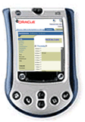
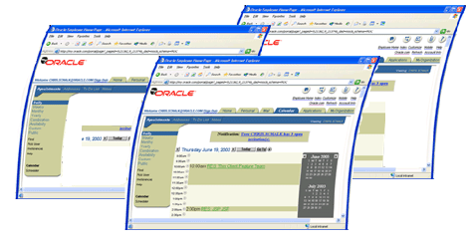
View Concept
A View does not contain application code; it contains code to represent the UI and pass events to the Controller.
Views are interchangeable without rewriting controller or model logic.
A single application can have different Views that are compatible with different types of devices (HTML browser, handheld devices, and so on).
Notes:
View Concept
In the past, the View contained almost every part of an application. The View managed data access, controlled user requests, handled application navigation, and did anything else that was needed as part of the application. This proved to be difficult to write and maintain, and also maintenance was expensive and sometimes impossible. It also created a very inflexible application, such that when business needs changed, it often required rewrites.
The View in the MVC architecture is interchangeable within an application. Views can use any number of technologies, for example, HTML browsers, handheld devices, mobile devices, and so on. A single application can have many different views that are compatible with each of these types of devices.

Slide 77
View Technologies in Oracle JDeveloper 10g
JavaServer Pages (JSP)
UIX
ADF JClient
Creating databound clients is the same in JDeveloper for any of these supported client technologies.
Notes:
View Technologies in Oracle JDeveloper 10g
JDeveloper supports developing a number of different view clients. Clients can be created in a Visual Editor that is the same for each type. That means that a developer can create different types of view components from the same tool, which reduces learning curve and improves productivity.

Slide 78
View: Summary
Views contain only display code.
Views do not contain application logic.
Views do not contain navigation logic.
Views are independent of the Controller and the Model.
Notes:
View: Summary
In the MVC architecture, Views contain only display-related code. They do not contain application or navigation logic. Views are also independent of the Controller and the Model. This allows for flexibility in design, implementation, and deployment.

Slide 79
ADF Technology Stack
JSP
ADF UIX
JSF
Swing/
ADF JClient
View
Struts
Controller
ADF Model
Model
Business Services
ADF Business Components
EJB Session Beans
Web Services
JavaBeans/ Other

Slide 80
ADF: Summary
Productive end-to-end development
Model-View-Controller
Visual
Declarative
Standard J2EE framework
Implements J2EE best practices
Uses the latest standards
Provides architecture choices
Is built on the MVC design pattern
Notes:
ADF: Summary
Oracle Application Development Framework is an MVC architecture–based framework. ADF provides for visual and declarative development of applications. Because it follows standard J2EE practices, it is deployable to any J2EE environment. ADF also enables developers to choose the technologies that they want to use for each part of an application.

Slide 81
Summary
In this lesson, you should have learned how to:
Identify the benefits of framework-based application development
Describe the Java 2, Enterprise Edition (J2EE) platform
Define the components of the Model-View-Controller architecture
Describe the benefits of Oracle Application Development Framework (ADF)
Describe the technologies used in each of the MVC layers

